Slide 1

Group 3 Project 4
By: Adam Abernathy, Divya Shakamuri, Mason Otto, Michael Talaga, Morgan Marino

Slide 2
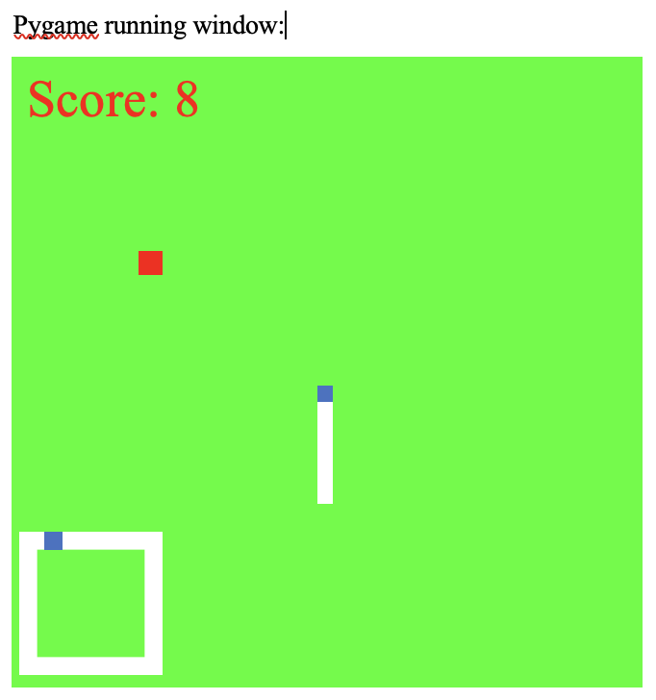
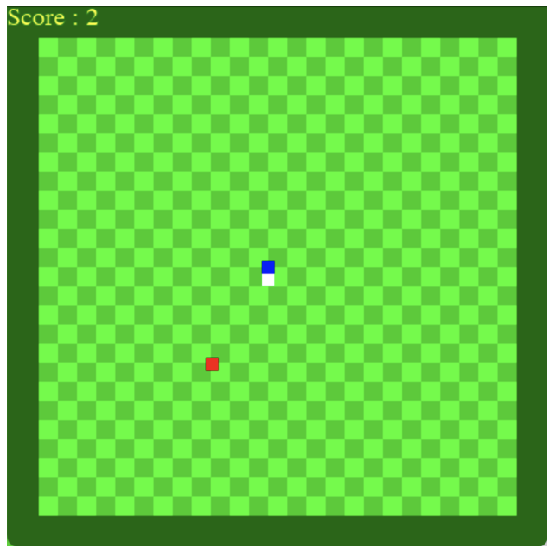
Introduction:
Project 3 User Interface Model
vs.
Project 4 User Interface Model
Goal: Create a new version of the Snake Game
Ideas for Project 3:
Apples = snake grows
Border = game over
Snake intersection = game over
Score = length of snake
Ideas for Project 4:
Sound effects
Main Menu
Golden ‘bonus’ apples
Grid
Code cleanup after review
Modes (regular/hard)

Slide 3

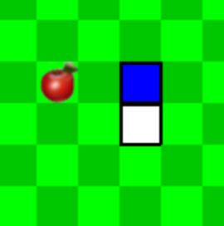
Documentation Overview
Before / After
Code Review:
Main method used: Walkthrough
Faults detected: Snake and grid not lined up, movement errors
How faults were fixed: Reworking of snake placing and movement code in snake.py
Deployment Plan:
Desktop app, create a logo, publish to Windows, expand to mobile, expand to IOS, “market, market, market!”
Cost: $99 investment (doesn’t include employee salary), profit can turn over into new investments (add $99+)
Integration Strategy:
All-at-Once Integration (Project 3), Sandwich Integration (Project 4)
Maintenance Plan:
Hiring developers, website maintenance, app servers, feedback
Cost: Developers ($70,000+), domain (up to $850/year), app servers (~$100)

Slide 4
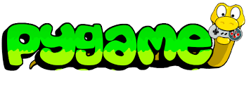
Pygame

Slide 5
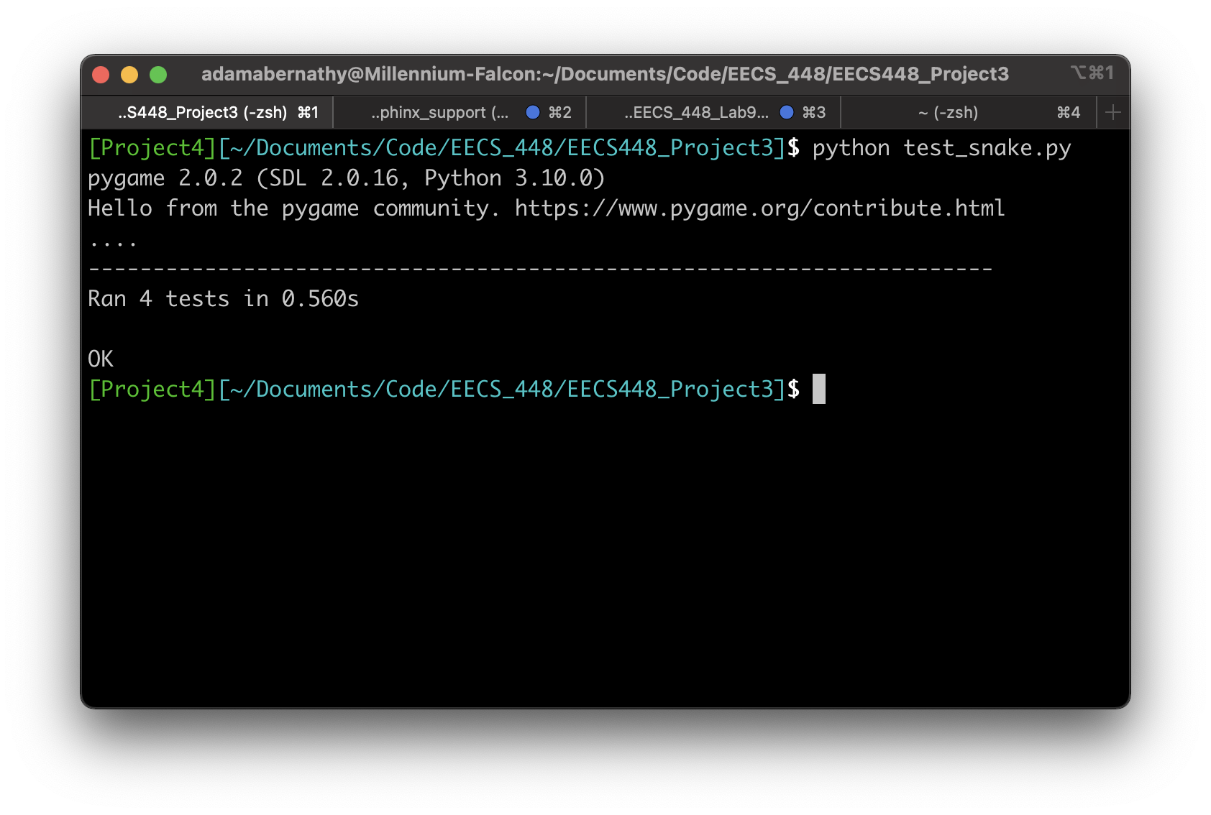
Unit Testing
Uses Pythons Unit Test Library
Tests the drawing of pygame, game area
Also tests keyboard input

Slide 6
Demo!
Pygame
pygame.org
Requirements:
Python 3.10.0
pygame installed
local copy of Github repo
To run:
in terminal, type “Python3 snakegame.py”

Slide 7

Notes:
https://youtu.be/PSL4YzGAjBM

Slide 8
Questions

